Slide 1
Digital Portfolio
STUDENT NAME: I DURAI MURUGAN
REGISTER NO : 24BSCS110
NMID:E71CBA883CA880A97924D726A8DA0BDC
DEPARTMENT: BSC COMPUTER SCIENCE
COLLEGE: SRI KRISHNA ADITHYA COLLEGE OF ARTS AND SCIENCE

Slide 2
PROJECT TITLE
“Web Portfolio Showcase”

Slide 3


AGENDA
Project Overview
End Users
Tools and Technologies
Portfolio design and Layout
Features and Functionality
Results and Screenshots
Conclusion
Github Link
3/21/2024 Annual Review

Slide 4

PROBLEM STATEMENT
Many students and professionals struggle to present their skills, projects, and achievements in a clear and visually appealing way online. Traditional resumes and static documents often fail to effectively showcase both technical expertise and personal branding.The goal of this project is to create an interactive personal portfolio website for Durai murugan I that provides a modern, user-friendly interface to highlight his skills, projects, contact details, and achievements, while also offering features such as resume download and direct messaging to potential employers, peers, and recruiters.

Slide 5

PROJECT OVERVIEW
This portfolio website showcases the academic and technical profile of Durai murugan I, a Computer Science student. It includes an About Me section, a Projects section highlighting practical work, a Contact Me form, and an option to download the resume as a CSV file. The website is designed to present personal achievements, skills, and projects in a clean, modern, and user-friendly layout.

Slide 6

WHO ARE THE END USERS?
Potential employers looking to evaluate skills and projects.College faculty for academic assessment.Peers or collaborators interested in projects or professional connections.Recruiters and tech professionals searching for talent in web development and programming.

Slide 7

TOOLS AND TECHNIQUES
HTML5 – structure and content of the website.CSS3 – styling, layout, and responsive design.JavaScript – dynamic features, including sending messages and downloading resume.CodePen – online development and testing platform.Blob API – to generate and download the resume CSV.

Slide 8
POTFOLIO DESIGN AND LAYOUT
Header / Hero Section: Centered greeting, short intro line, and a “View My Work” button.About Me Section: Profile photo in the center, description lines about academic and personal interests, and a download resume button.Projects Section: Three horizontally aligned project boxes describing individual projects.Contact Me Section: Vertical layout with name, email, phone, message box, and send button.Footer: Simple copyright text.Overall Style: Clean, modern, minimalistic with consistent colors (#1f315b, #ffd700, #eef1f5), rounded edges, and shadow effects for depth.
8

Slide 9
FEATURES AND FUNCTIONALITY
Interactive Buttons: “View My Work” and “Send” button provide user interaction.Contact Form: Users can enter a message and click “Send” (simulated with alert).Download Resume: CSV download of user’s basic info, projects, and skills.Responsive Layout: Sections and boxes adjust to screen width using flexbox.Project Highlights: Three project boxes give a quick overview of work.

Slide 10
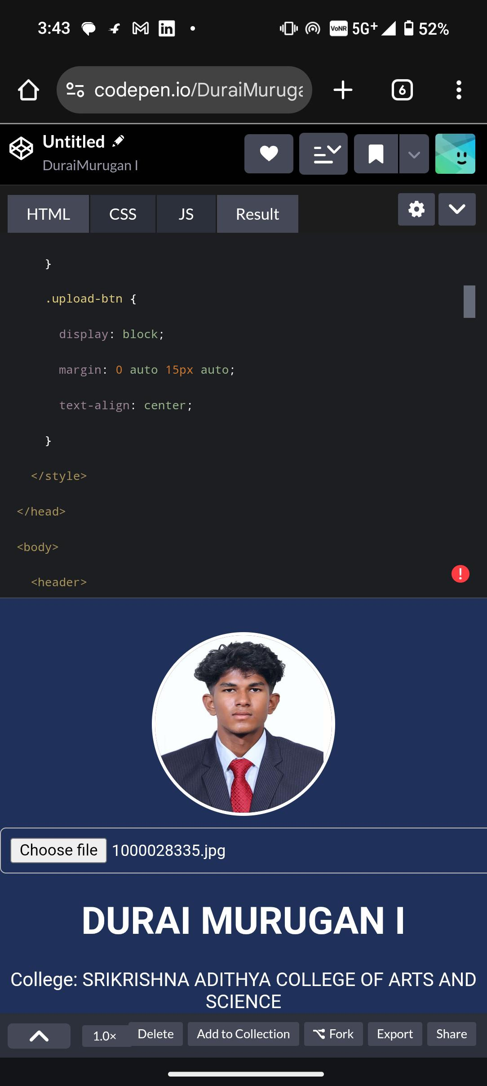

RESULTS AND SCREENSHOTS
10
3/21/2024 Annual Review

Slide 11
CONCLUSION
The portfolio website is a professional and visually appealing showcase of Durai murugan i
skills, projects, and contact details. It demonstrates the ability to use HTML, CSS, and JavaScript effectively to create an interactive and user-friendly interface. The website is scalable, allowing new projects, skills, or sections to be added easily. It serves as a strong personal branding tool for potential employers, collaborators, and recruiters.
11

